Slide 1

Capstone Project – Olympic Games

Slide 2
Olympic
Overview
Olympic sports analysis involves the systematic assessment of various facets of the Olympic Games. This Event analysis focuses on the structure and rules of specific competitions, while participant analysis assesses athlete performance and health. Medal analysis scrutinizes medal distribution and trends, and region analysis examines the representation and performance of different areas. This analysis provides valuable insights for organizers, athletes, and fans, shaping the future of the Olympic Games.

Slide 3
Games Analysis
Objective
Participants Analysis
Sports Analysis
Regional Analysis

Slide 4
Objective
Objective
The objectives of Olympic sports analysis include evaluating the overall success of the Games, assessing their long-term impact, and examining the performance of individual sports and athletes. It aims to identify trends, rule changes, and technological advancements that may affect sports performance.

Slide 5
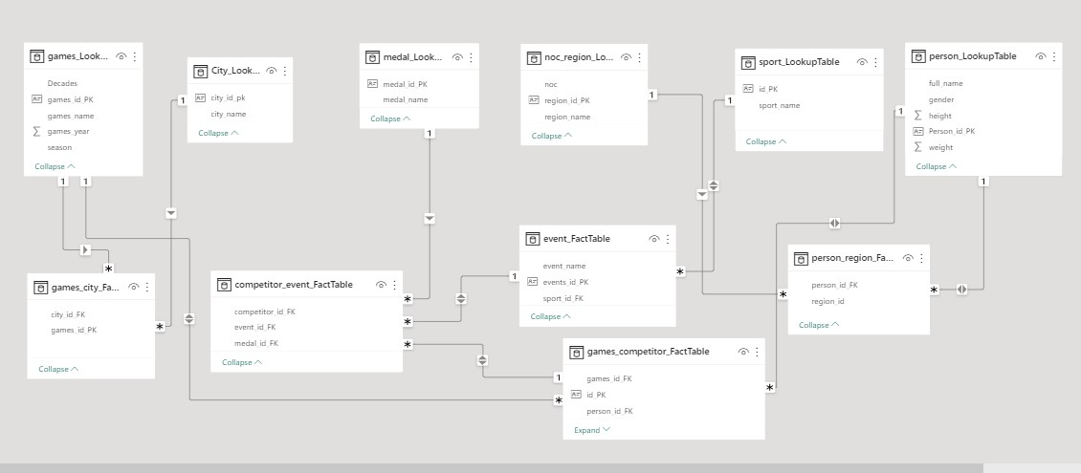
ER Diagram

Slide 6

Power Bi Problem Statement

Slide 7
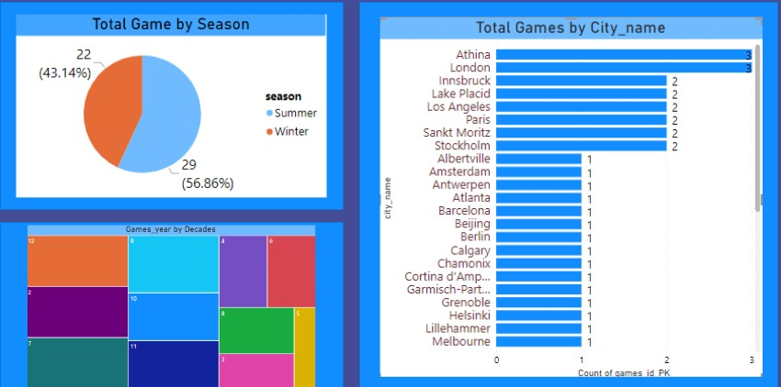
Games Analysis

Slide 8
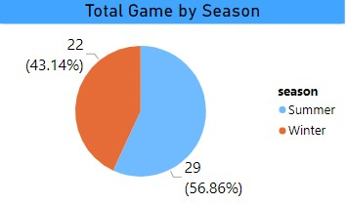
How many Olympic Games have been held in each season (Summer vs. Winter)?
As the visual suggests, more number of games are played in summer season(57.86%) than in winter (43.16%).

Slide 9
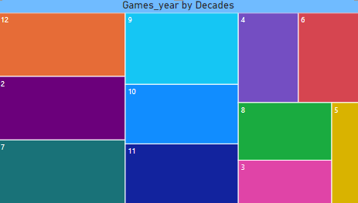
2.What is the distribution of games across different decades?
Visual representation of number of games played over decades.

Slide 10
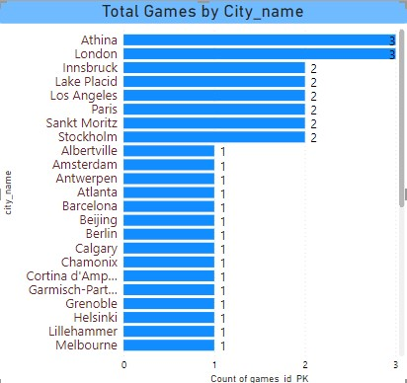
3.Which cities have hosted the most Olympic Games?
As the visual suggests Athina and London cities has been the host for maximum numbers of Olympics. Each has hosted three Olympic games.

Slide 11
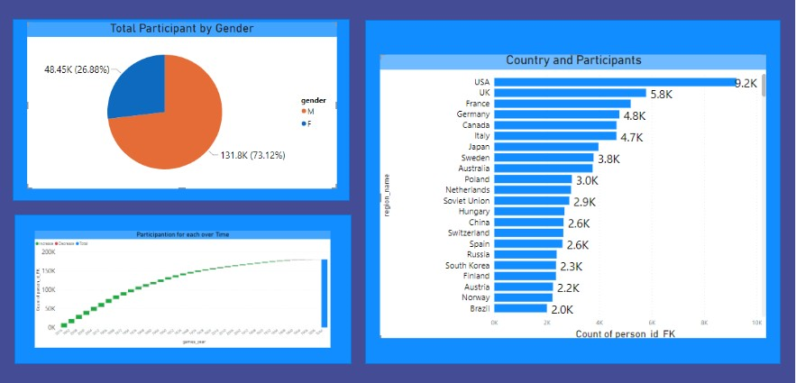
Participants Analysis

Slide 12
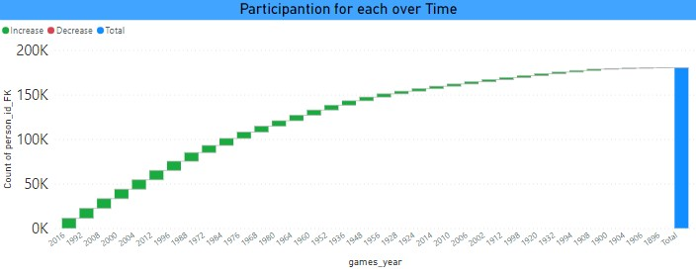
4.How has the participation in each sport evolved over time?
This chart depicts the trend for count of participants per Olympic over time.

Slide 13
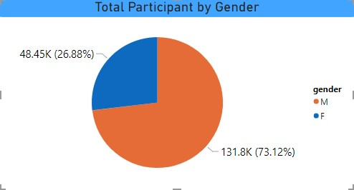
5.What is the distribution of participants by gender?
As the visual suggests, participation in terms of gender has been dominated by male participants.
Male participants are 73.12% of total participants whereas females consist of only 26.88%.

Slide 14
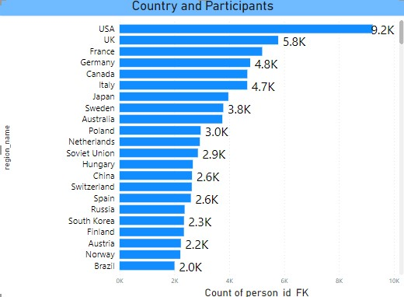
6.Which countries have the highest number of participants in the Olympics?
As it is visible in the bar chart, participants in terms of region they belong to, is dominated by western countries.
United States of America has highest number of participants followed by United Kingdom and France.

Slide 15
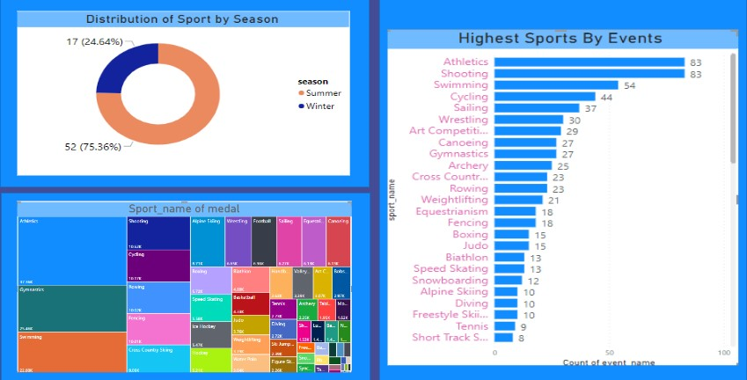
Sports Analysis

Slide 16
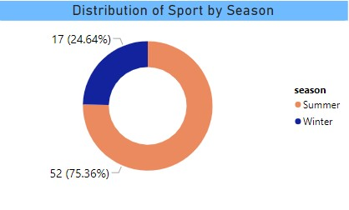
7.What is the distribution of sports between Summer and Winter Olympics?
As this pie chart shows 2/3rd of the total sports have got played in summers and only 1/3rd in winter.

Slide 17
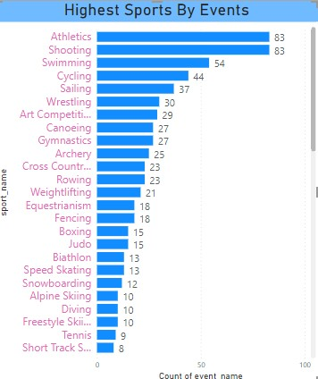
8.Which sports have the highest number of events in the Olympics?
As the bar chart suggests, Athlectics and shooting are the sports that take the major chunks of total events . Each holds 10.90% events of total, followed by swimming which is 7.13%.

Slide 18
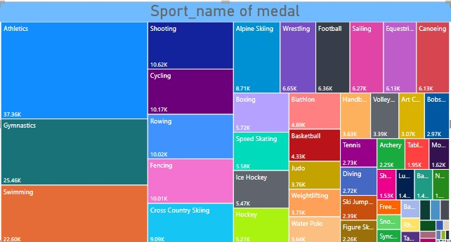
9.How does the medal distribution vary across different sports?
This tree map depicts the medal distribution across different sports.
Athletics has got maximum number of medal followed by Gymnastics.

Slide 19
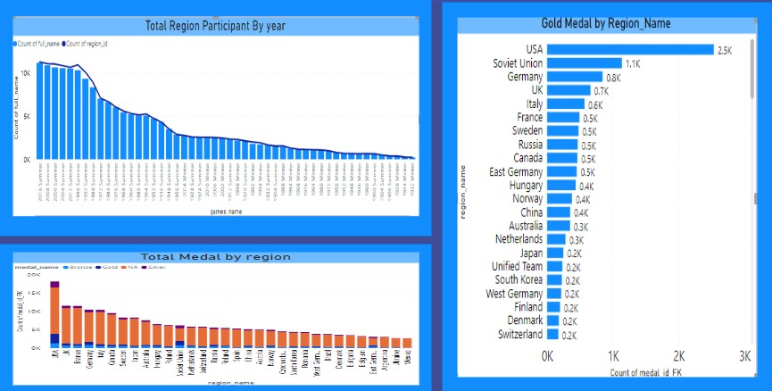
Regional Analysis

Slide 20
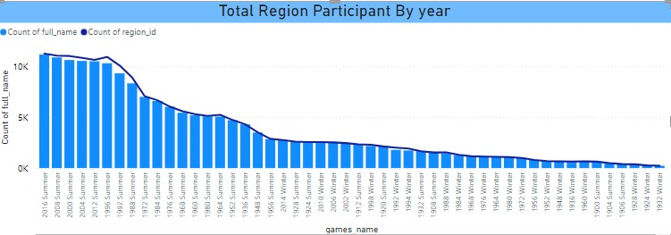
10.How many regions or NOCs participate in each Olympic Games?
This column chart shows the trend of region or country participation over the years.

Slide 21
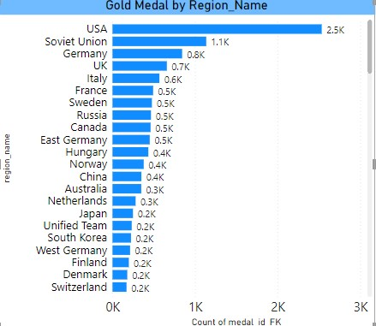
11.Which countries have the highest number of gold medals?
As suggested by this bar chart, USA has won maximum number of gold medal followed by Soviet Union.
But here is a interesting contrast, Soviet Union do not have the 2nd position in terms of player participation but it has won 2nd most gold medals after United States.

Slide 22
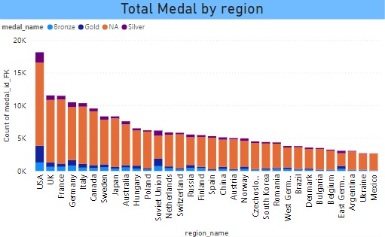
12.What is the distribution of medals among different regions?
This column charts explains the relationship between medals and region.
As the chart depicts, USA has won most number of medals followed by UK and France.

Slide 23
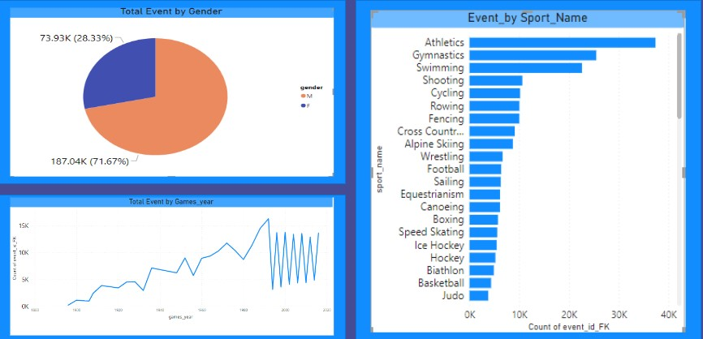
Event Analysis

Slide 24
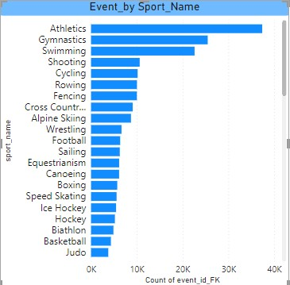
13.How many events are there in each sport?
As this bar chart shows, most number of events has been related to Athletics sports followed by gymnastics and swimming. This also indicates towards the number of participants of Athletics, that is also highest.
Correlation can be realized between number of participants for particular sports and number of events have to be organized for them.

Slide 25
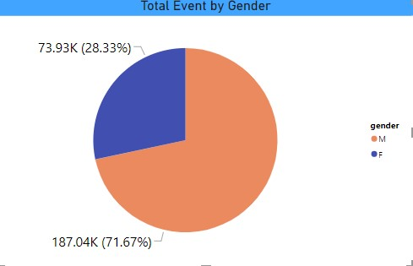
14.What is the distribution of events by gender (Men, Women, Mixed)?
As we can see in this pie chart, almost 2/3rd (71.67%) of total events are for men only.

Slide 26
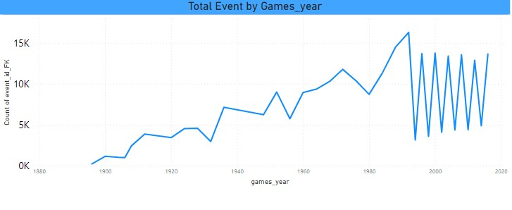
15.How has the number of events changed over time?
After a upward trend for some year its a zig-zag trend .

Slide 27
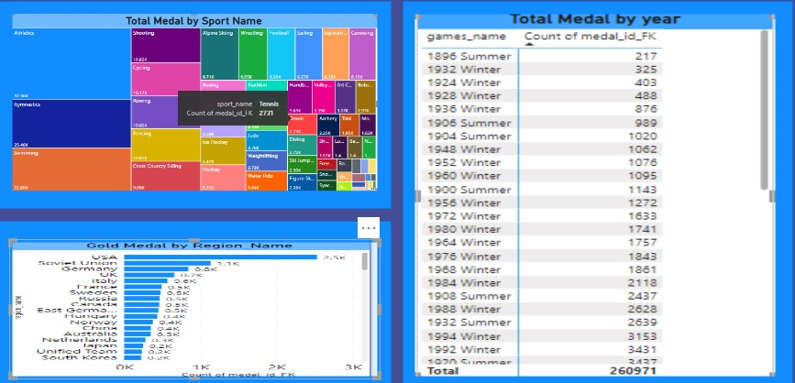
Medal Analysis

Slide 28
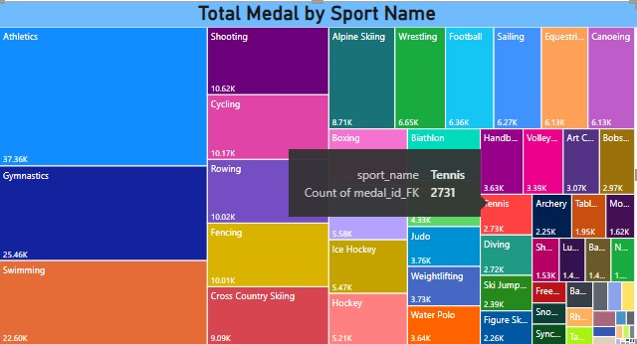
16.How does the medal distribution vary across different sports?
As this tree map suggests, Athletics sport has got most number of medal followed by Gymnastics.

Slide 29
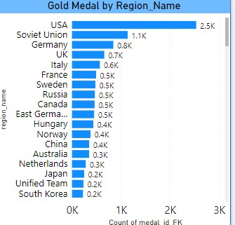
17.Which countries have the highest number of gold medals?
USA has won highest number of gold medals, followed by Soviet Union.

Slide 30
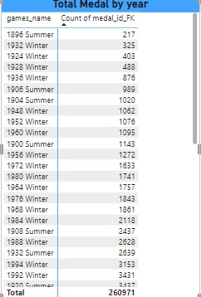
18.How many medals have been awarded in each Olympics?
This report provides a visual representation of the number of medals awarded in each Olympic year. It offers insights into the historical trends of medal distribution across different Olympic games.

Slide 31
EDA Problem Statement

Slide 32
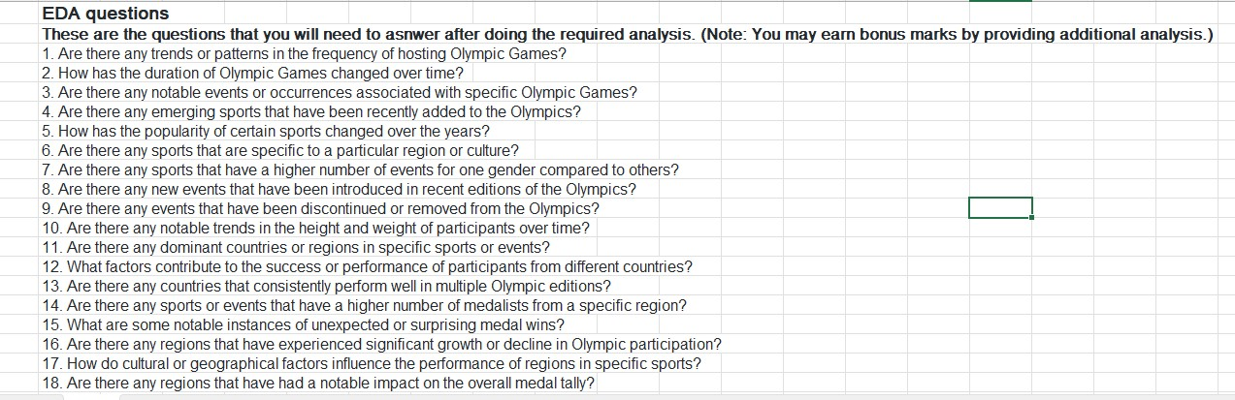

Slide 33
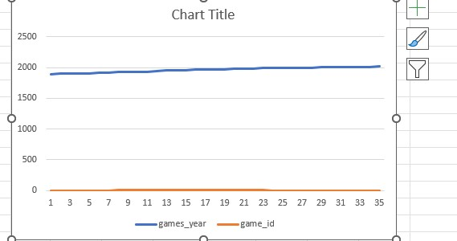
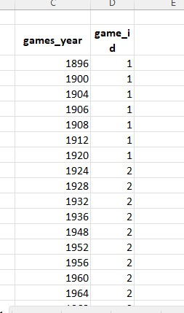
1. Are there any trends or patterns in the frequency of hosting Olympic Games?
Not really, for first few years it was one Olympic per year before turning into two Olympics per year and it is the same since then.

Slide 34
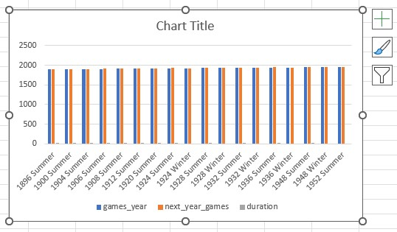
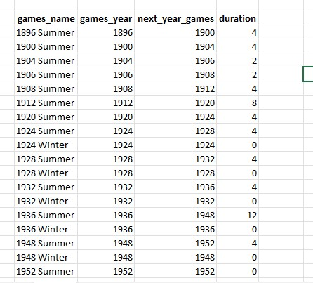
2. How has the duration of Olympic Games changed over time?
It retrieves information about the Olympic Games, specifically the name and year of each game, as well as the following year's game and the duration between consecutive games.

Slide 35
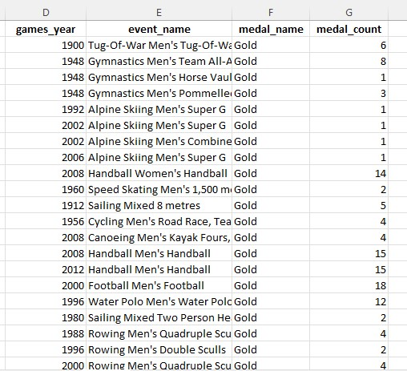
3. Are there any notable events or occurrences associated with specific Olympic Games?
It specifically focuses on events where a gold medal was awarded. retrieves information about notable events or occurrences associated with specific Olympic Games, focusing on events where gold medals were awarded.

Slide 36
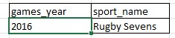
4. Are there any emerging sports that have been recently added to the Olympics?
Rugby sevens sport was added in lates edition of Olympic i.e 2016.

Slide 37
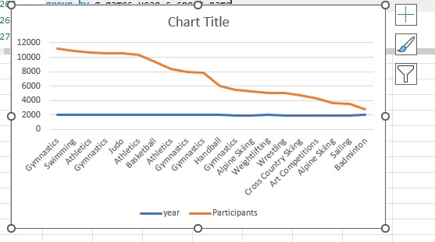
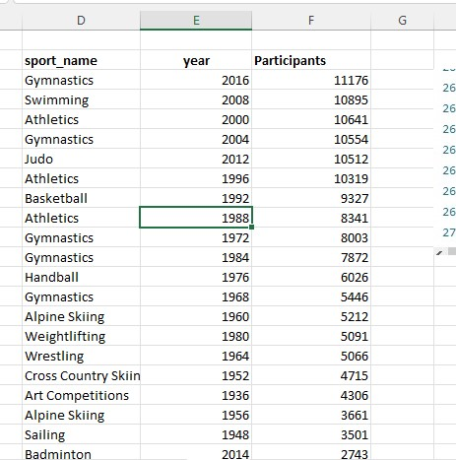
5. How has the popularity of certain sports changed over the years?
As the line chart suggests, there is a upward trend in popularity of sports.

Slide 38
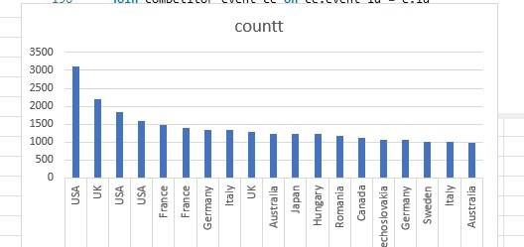
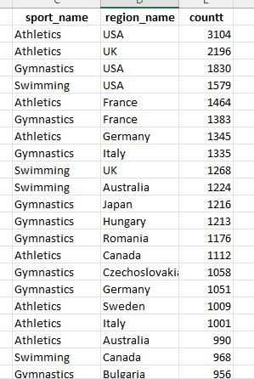
6. Are there any sports that are specific to a particular region or culture?
For many games like Athletics, Gymnastics, Swimming , number of player participated from USA is much higher than the rest of the countries, which is a clear indication of domination of United States in these particular games.
This finding can be justified by medal tally also.

Slide 39
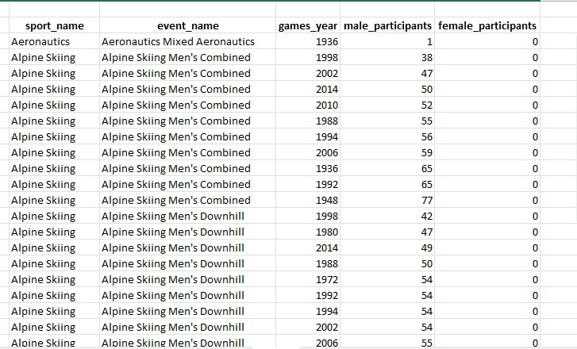
7. Are there any sports that have a higher number of events for one gender compared to others?
Yes, Infact there are many sports having more number of event for male participants than female.

Slide 40
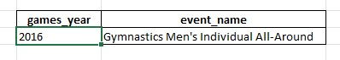
8. Are there any new events that have been introduced in recent editions of the Olympics?
Gymnastics Men’s individual All-Around was introduced in recent edition of Olympic.

Slide 41
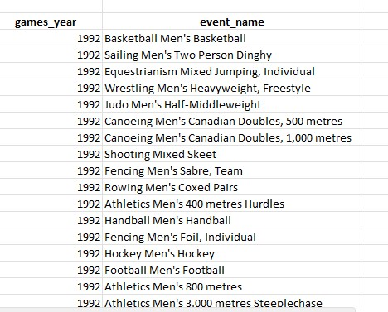
9. Are there any events that have been discontinued or removed from the Olympics?
Yes, number of events have got discontinued.

Slide 42
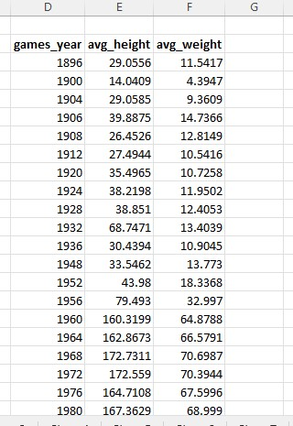
10. Are there any notable trends in the height and weight of participants over time?
Each row will represent a unique year, and it will show the average height and weight of participants for that year. This information can be used to identify any notable trends in the height and weight of participants over time.

Slide 43
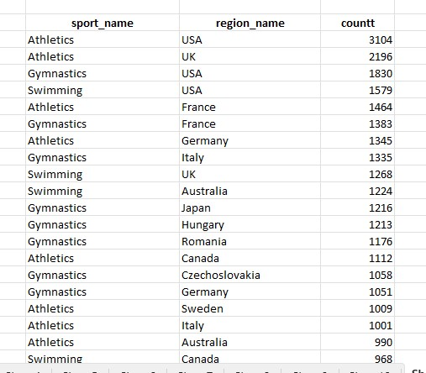
11. Are there any dominant countries or regions in specific sports or events?
Clear domination of USA is visible in Athletics, Gymnastics and Swimming.
It provide information about which regions or countries are dominant in specific sports based on the total number of medals won

Slide 44
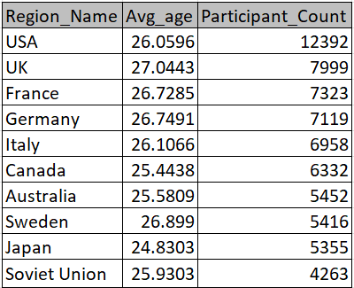
12. What factors contribute to the success or performance of participants from different countries?
Note: In light of the absence of pertinent data in the dataset, I will now proceed to examine a fresh perspective -
What is the average age of participants and the count of participants in each region?

Slide 45
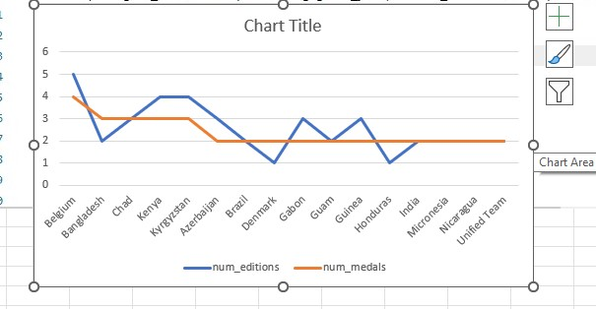
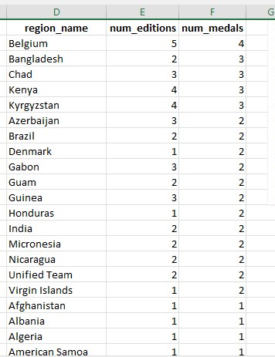
13. Are there any countries that consistently perform well in multiple Olympic editions?
It include countries that have participated in at least two editions and orders the result by the number of medals in descending order.

Slide 46
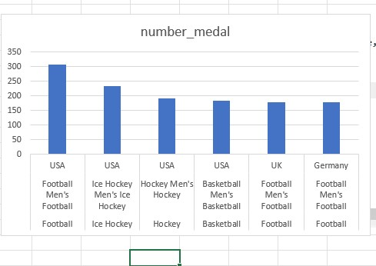
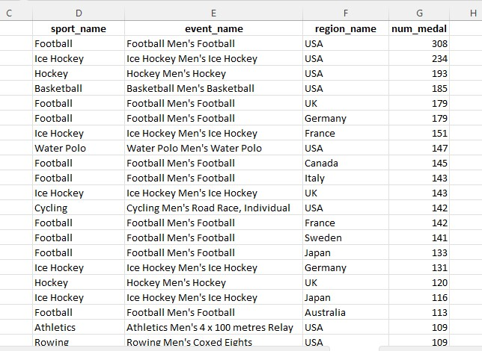
14. Are there any sports or events that have a higher number of medalists from a specific region?
Yes, in Football Men’s, USA tops the tally by a great margin, infact in many sports such as
Ice hockey, Hockey Men’s, Basketball Men’s USA is tally topper.

Slide 47
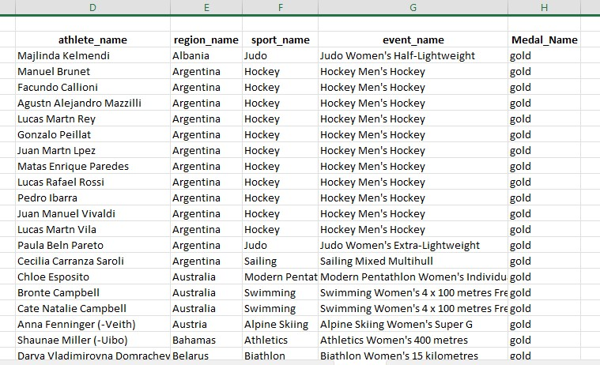
15. What are some notable instances of unexpected or surprising medal wins?
It will return athletes who won gold medals between 2014 and 2016 and had a previous unexpected or surprising bronze medal win in the specified time frame.

Slide 48
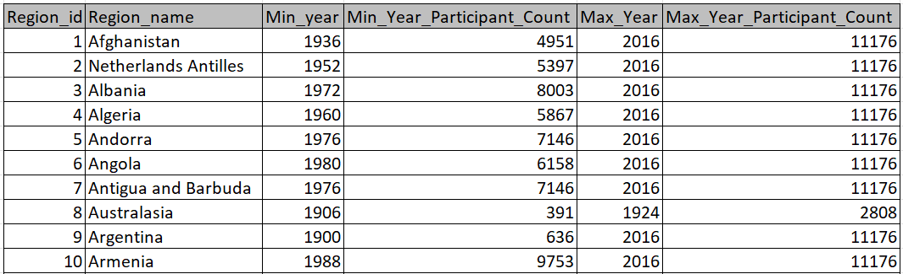
16. Are there any regions that have experienced significant growth or decline in Olympic articipation?
It retrieves information about regions, including their IDs, names, the earliest and latest years of Olympic participation, and the total number of distinct participants.

Slide 49
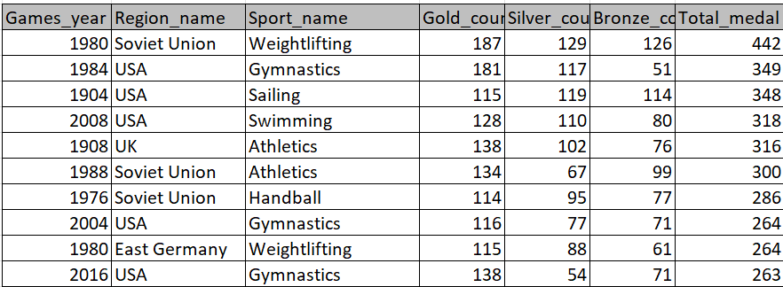
17. How do cultural or geographical factors influence the performance of regions in specific sports?
Note: In light of the absence of pertinent data in the dataset, I will now proceed to examine a fresh perspective -
What is the distribution of gold, silver, and bronze medals won by regions in each year for different sports, along with the total number of medals won?
It including the year of the games, the region, the sport, and various counts related to the medals awarded (Gold, Silver, Bronze) for each combination of year, region, and sport.

Slide 50
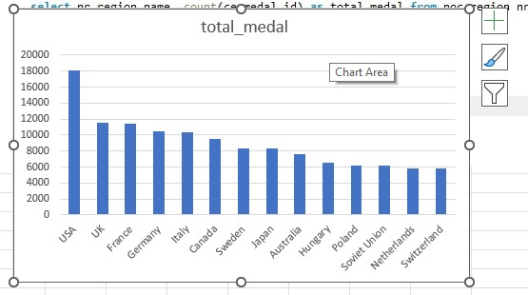

18. Are there any regions that have had a notable impact on the overall medal tally?
As it is visible in column chart, USA is a distant first in overall medal tally.

Slide 51
Findings : In this whole analysis process we explored all possible perspective, evolution and stakeholder to analyzed the data comprehensively and holistically. After the analysis we can come to a conclusion that there is a gender domination and regional domination as far as the medal and participation is concerned.
Absence of some relevant data lead us to be unable to find some crucial factors that could have been responsible for a particular result likes of regional domination and gender domination in some particular sports.

Slide 52
Thank You

